Slide 1



Foundation of AI
Smart Hackathon Team Formation System
BY
MUKUNDHAN MV
CHANDRU RR

Slide 2

Abstract
A smart hackathon platform that helps students form teams, discover incomplete teams, send join or merge requests, and register for hackathons. Organizers can create and manage hackathons, define participation rules, and monitor teams. The platform provides centralized and reliable management of hackathon activities, with AI-based team matching planned as a future enhancement.

Slide 3
Problem Statement
Students often face difficulty in finding suitable teammates and forming complete teams for hackathons. Existing methods rely on manual communication and do not provide an organized way to discover incomplete teams, join teams, merge partial teams, and manage registrations.
Organizers also need an efficient system to create hackathons, define rules, manage teams, and monitor participation. Therefore, there is a need for a centralized platform that simplifies hackathon management and team formation.

Slide 4
Literature Survey
Existing hackathon platforms mainly focus on event creation, participant registration, and project submission.
Collaboration platforms provide communication and group management but are not specifically designed for hackathon team formation.
Existing approaches generally do not provide a unified process for incomplete-team discovery, join requests, team merging, and hackathon registration.

Slide 5
Research Gap
  Existing systems mainly focus on hackathon management or skill-based team matching.
  Limited support is available for finding incomplete teams without restrictive filters.
  Existing platforms often lack join and merge mechanisms for partial teams.
  There is no unified workflow combining hackathon creation, flexible team formation, team joining/merging, and registration.
  Therefore, a centralized platform is needed to provide a simple and flexible team formation process for hackathon participants.

Slide 6
Reasearch objective
  To develop a centralized platform for managing hackathons and participants.
  To provide students with flexible options for individual, partial-team, and full-team registration.
  To enable students to discover incomplete teams and connect with other participants.
  To support join and merge requests for completing partial teams.
  To help organizers create hackathons, define rules, and manage participation efficiently.
  To provide a reliable system for managing team formation and hackathon registration.

Slide 7
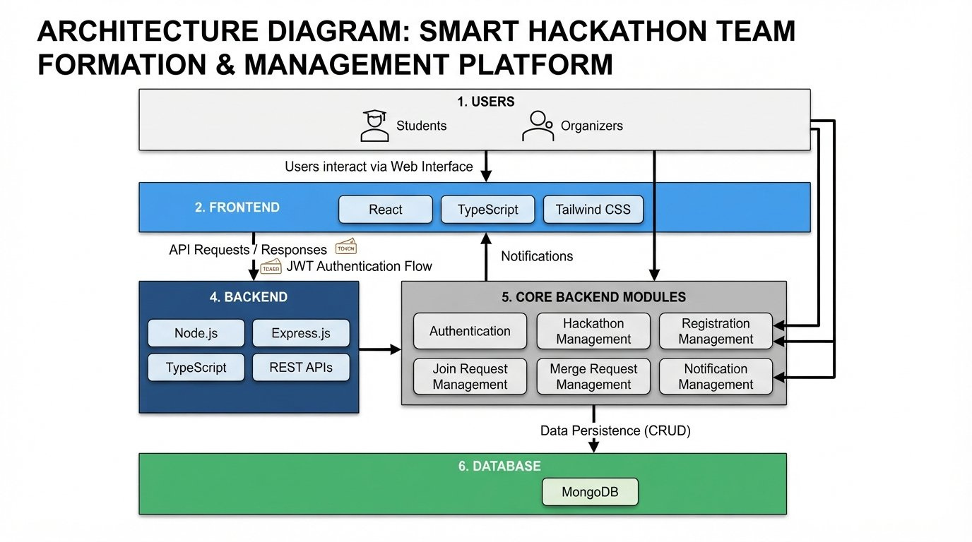
Architecture Diagram

Slide 8
Tech Stack
Frontend
  React
  TypeScript
  Tailwind CSS
Backend
  Node.js
  Express.js
  TypeScript
  REST APIs
Database
  MongoDB
Development Tools
  VS Code
  GitHub

Slide 9
Algorithm
Forward Chaining Algorithm
Forward Chaining is a data-driven inference technique used in rule-based AI systems.
It starts with known facts and applies IF–THEN rules to derive new facts and conclusions.
In our project, it checks hackathon status, registration type, team size, and eligibility rules.
The process continues until a team formation decision is reached.
Flow:
Facts → IF–THEN Rules → Forward Chaining → Decision
Example:
IF hackathon is published + team has space + student is eligible
THEN → Allow Team Formation

Slide 10
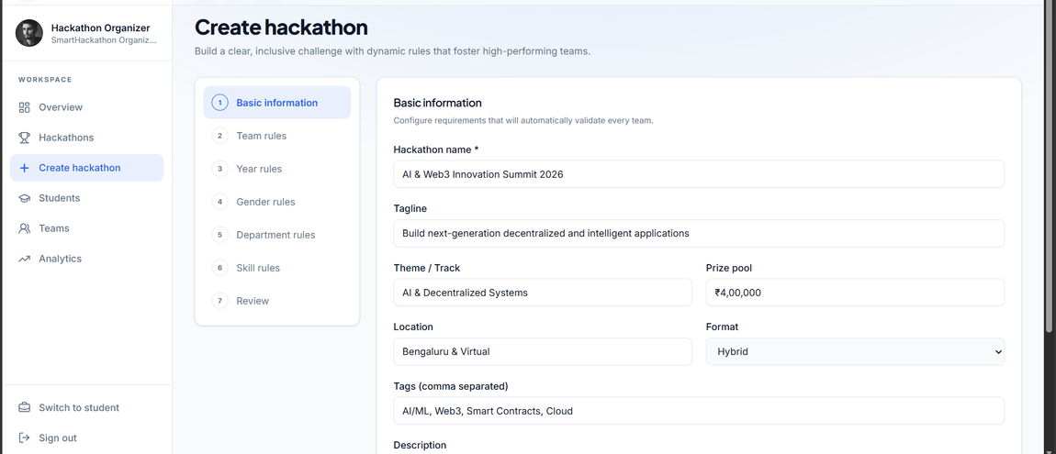
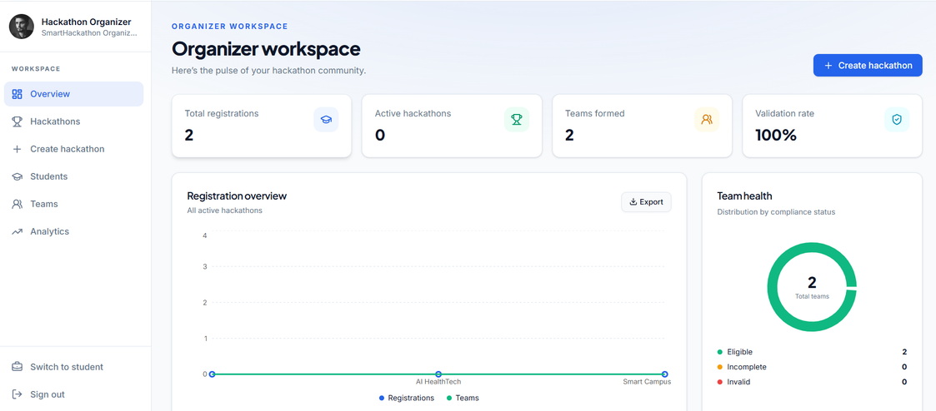
Output
Organiser

Slide 11
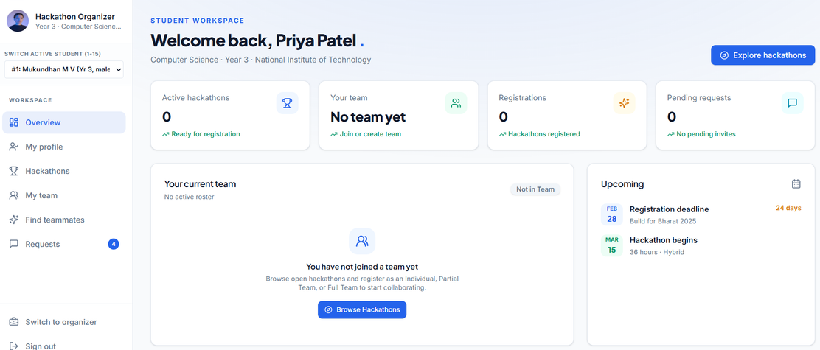
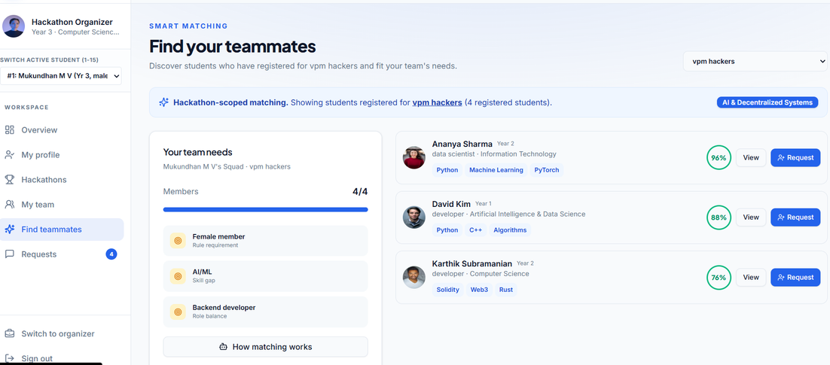
Output
Students

Slide 12
Thank You

